Slide 1
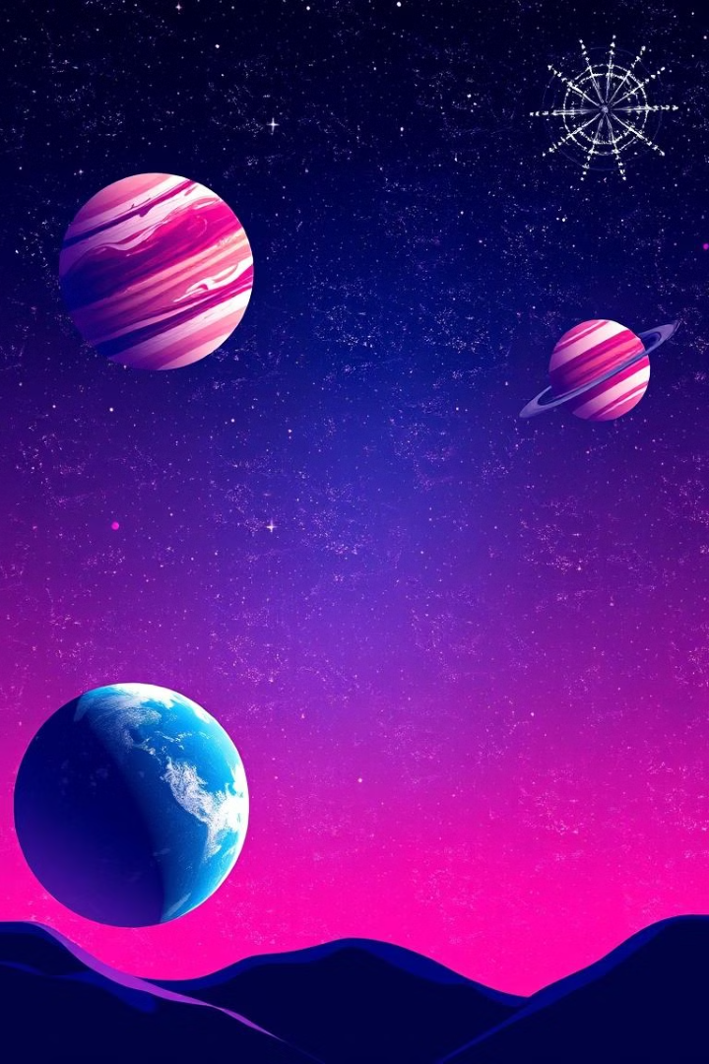

Immersive Solar System Exploration
Welcome to our immersive web application, a journey through the solar system and beyond.
By Team Promothéus
Arji Jethin Naga Sai Eswar
Aluru Bala Karthikeya
Akshat Choudhary
Vinod Sambrani

Slide 2
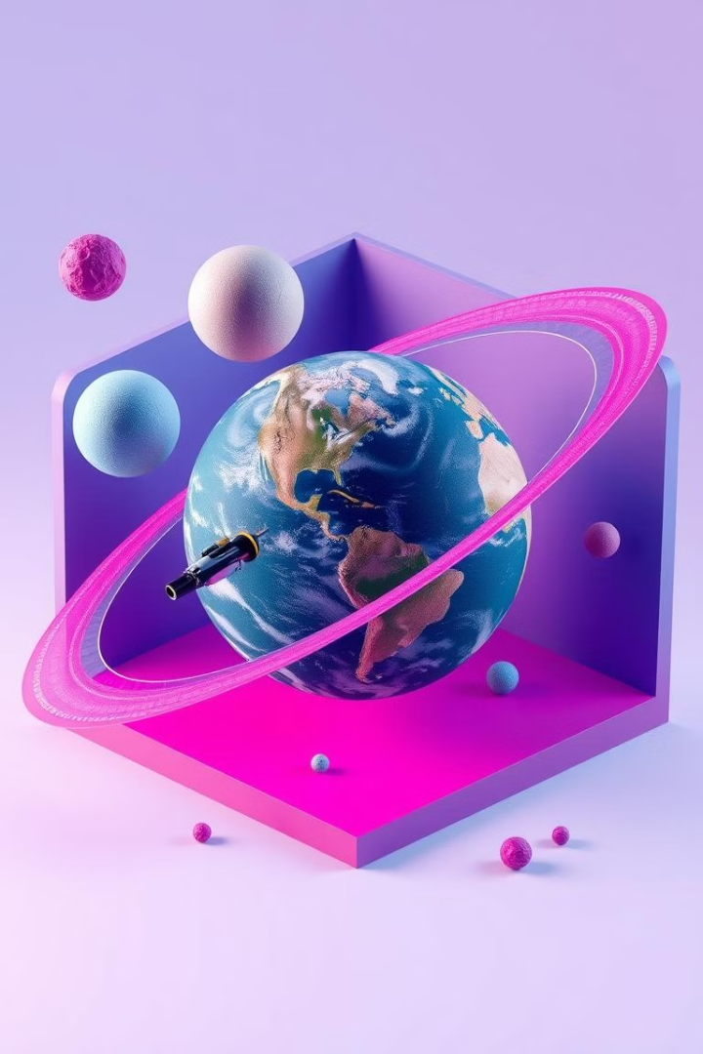
Navigating the Cosmos
1
Solar System
Explore our home planet & the Solar system, with interactive features that showcase its diverse landscapes and geological formations.
2
ExoPlanets
Discover amazing Exo Planet, with a focus on its potential for past or present life, featuring detailed visuals of its surface.
3
Interact with them
Dive into the Planets, witnessing their majestic features and intriguing systems, emphasizing their immense scale and unique characteristics.

Slide 3
Discovering Exoplanets
55Cancri e
PegasiB
TOI-1452b
Another star that orbits to its host stars taking under 18hrs to complete an Orbit. 55Cancri E is also inhospitably hot-reaching temperatures as high as 4,712 degrees F (2,300 degrees C)
51 Pegasi is the Flamsteed designation of the host star. The planet was originally designated 51 Pegasi b by Michel Mayor and Didier Queloz, who discovered the planet in 1995
The TOI-1452 star system is 99 light-years away from Earth, located in the constellation of Draco. It is a binary pair of dim red dwarf stars separated by only 96 astronomical units (AU)

Slide 4
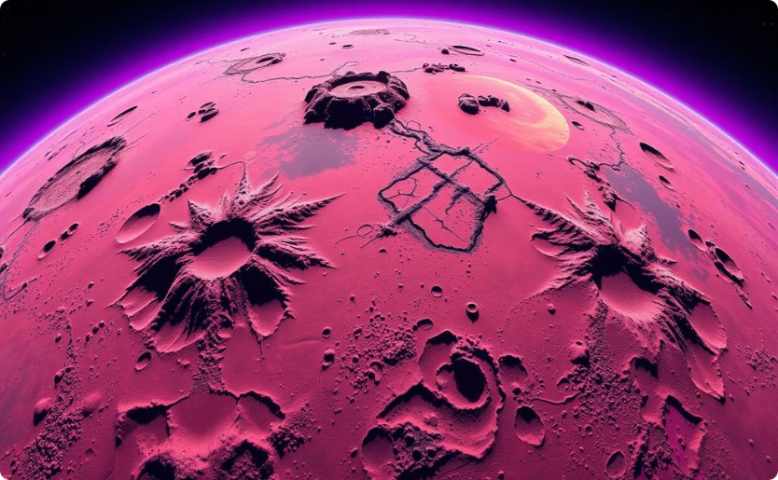
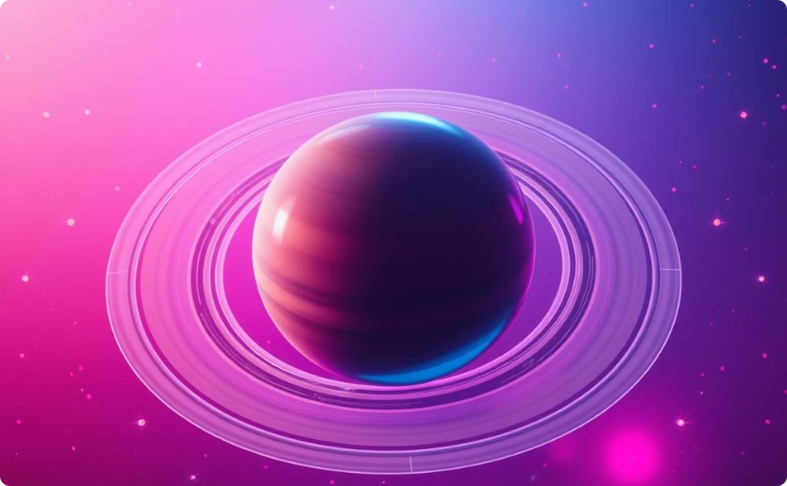
Interactive 3D Models
Planets Surface
Amazing Ring Systems
Explore the Exo Planet's diverse landscape with interactive 3D models, allowing users to explore its surface in detail.
Discover the beauty and complexity of Exoplanet's rings with interactive 3D models, allowing users to explore their structure and composition.

Slide 5
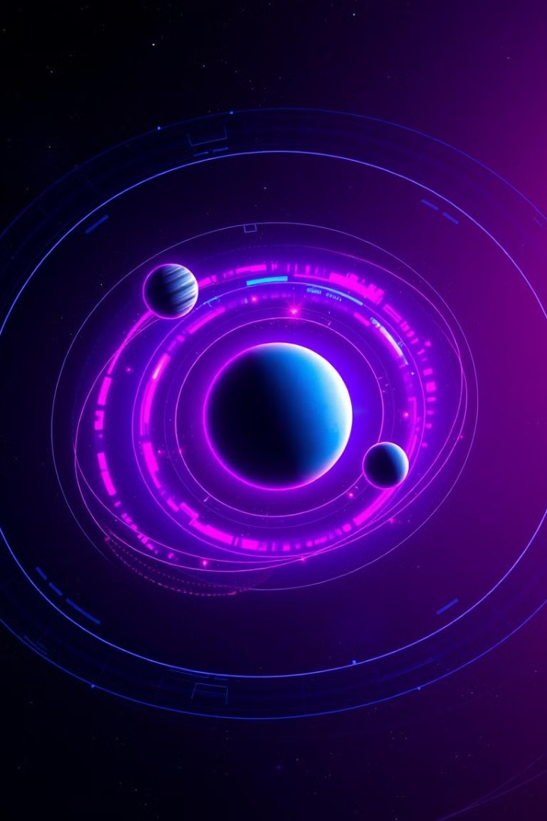



Learning Through Simulation
Atmosphere
Witness the atmosphere that shapes planetary conditions, demonstrating the power of atmosphere and its influence on celestial bodies.
Orbital Mechanics
Understand how planets move around stars, exploring the laws of physics that govern their motion.
Planetary Formation
Experience the process of planetary formation from a cloud of gas and dust, showcasing the stages and events that lead to the creation of planets.

Slide 6
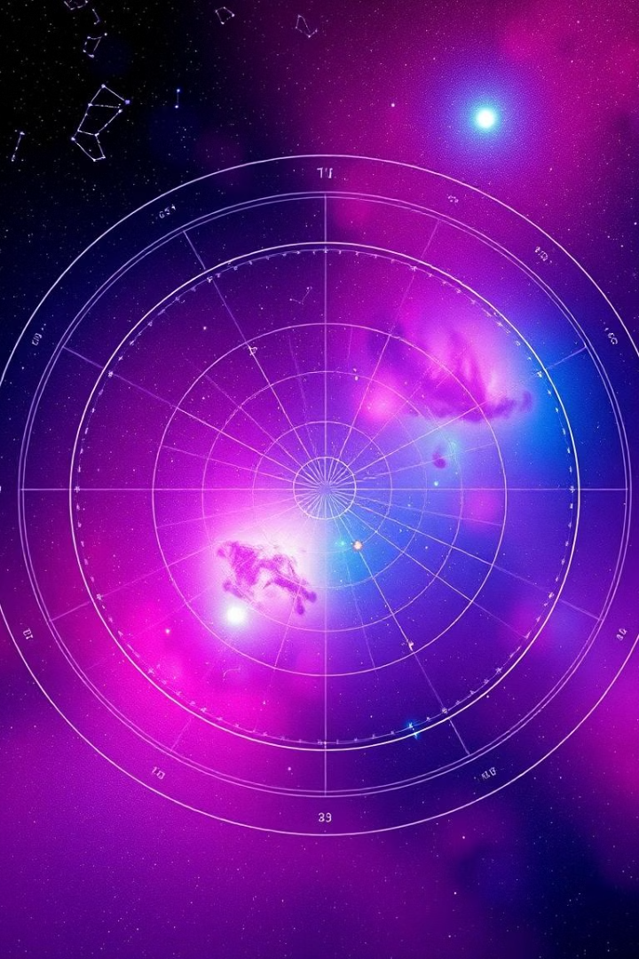



Connecting with the Cosmos
Stargazing
Explore the night sky with a virtual star chart, identifying constellations and distant galaxies.
Space Travel
Experience a simulated journey to other planets and celestial bodies, showcasing the challenges and wonders of interstellar travel.
Cosmic Events
Witness the awe-inspiring events of the universe, such as supernovae and black holes, highlighting their impact and significance.

Slide 7
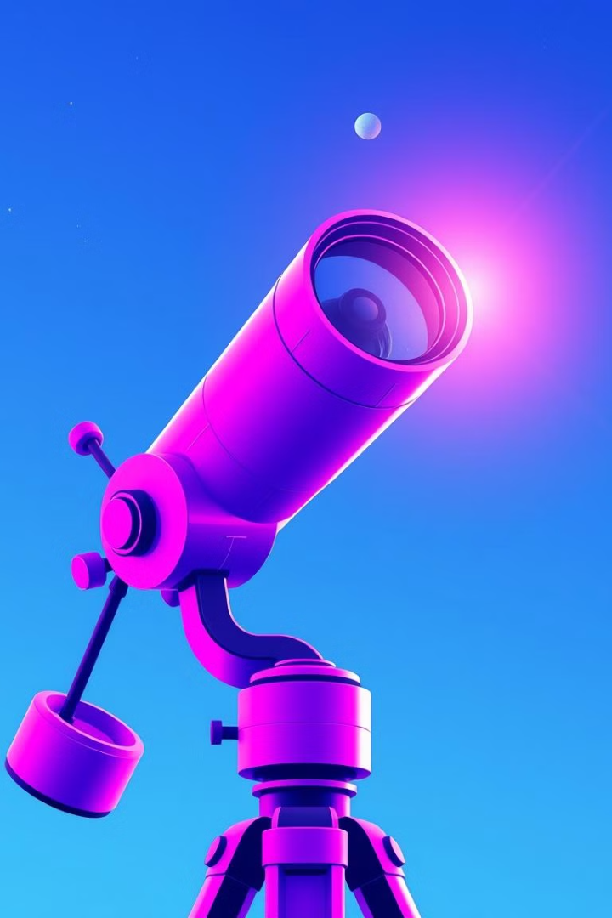
Conclusion and Next Steps
This immersive web application offers a unique opportunity to explore the solar system and beyond, fostering a deeper understanding of our place in the universe.
We are committed to expanding the application with new features and content, including updated scientific discoveries and interactive simulations.

